Slide 1

Team 201 Sprint 3

Slide 2
Plan for this Sprint
Planning for the problem would happen immediately
Rather than having 1 task worth a large weight, tasks would be divided into small functions
Some initial functions that are good for helping would be developed first (for example, checking a course conflict)
A working version would be developed
Later tasks would either offer expansions to the functions, fix bugs, or create new functions to offer more options

Slide 3
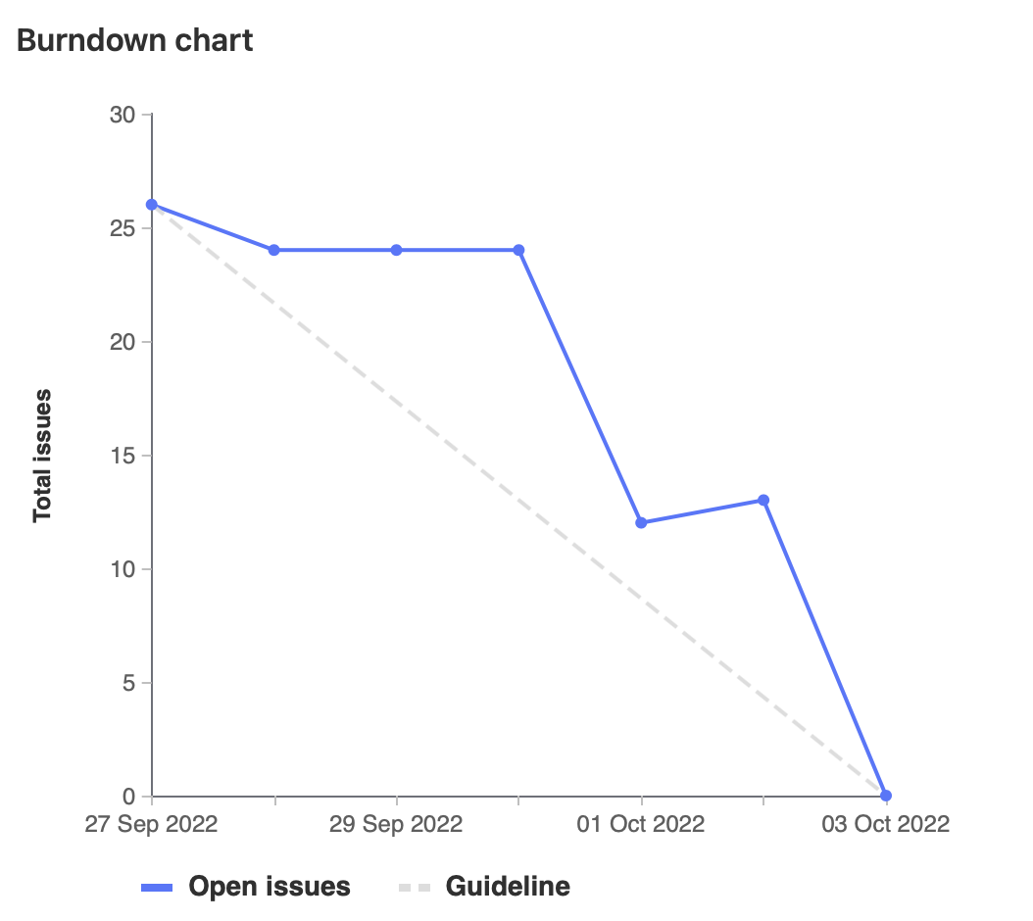
Burndown Chart
Small plateau due to tasks being put into "In Review" but not moved to closed
Large task cleanup occurred on the weekend

Slide 4

The Good
Pre-planning before the initial sprint meeting reduced time from 2hr to 1hr
Cameron was able to get back to the team
Small tasks allowed for easier planning
Small tasks allowed different approaches to work well together
Custom weights allowed putting as much time as needed into a task without an actual weight
Documentation on person's activity allowed for proper

Slide 5
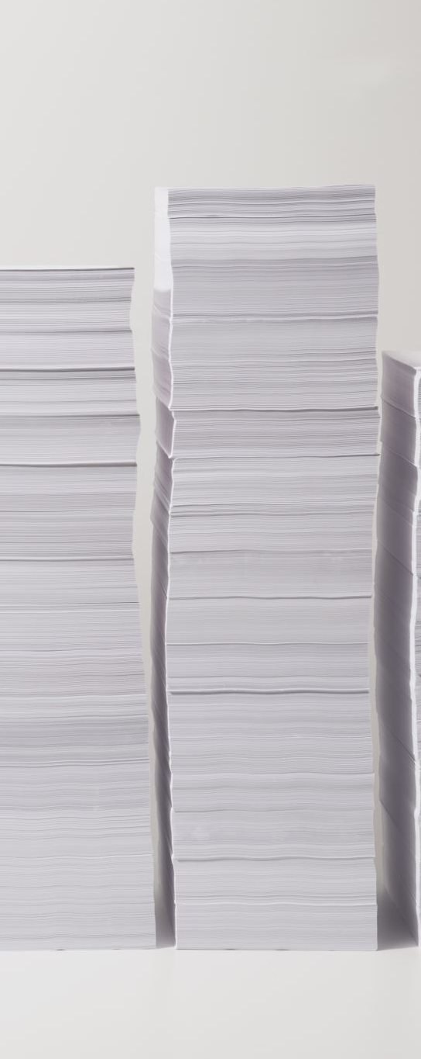
The not as Good
Lots of tasks were under-estimated beforehand
Through a majority of the week, not much work was being done
Tasks were done in groups rather than 1 at a time
Some tasks were resolved by other tasks, making them unnecessary
Some tasks needed to be abandoned
Weight Documentation was dependent on informing, lots of monitoring required
VBA was difficult to work with

Slide 6
For Future Sprints
Sprint leads need to write out tasks before the meeting, but not fill them with weights
Meeting on Thursday/Friday to catch up
Small work throughout the week if possible
Tasks should be designed so they produce a physical result, rather than multiple conjoining to create that result

Slide 7
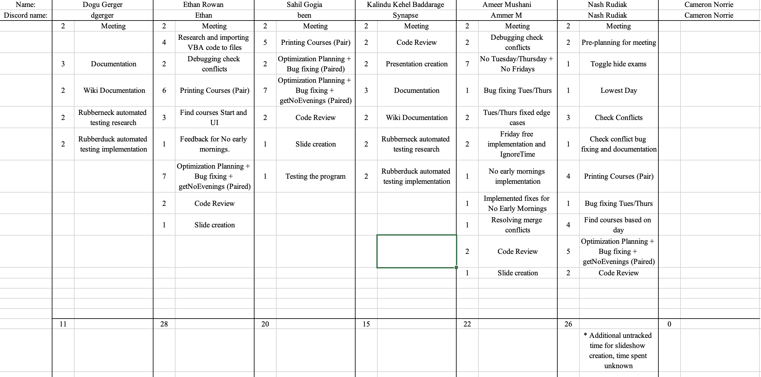
Time Tracking Document

Slide 8
Team Contributions

Slide 9
Ethan
Separated the VBA code from the excel file (GL67) [2h]
Implemented the schedule helper and supporting functions (GL56,GL58,GL63) [2.5h]
Cleaned up the code and bug fixes (GL80) [3.5h]
Total weight: 27

Slide 10
Ameer
Developed helper functions for schedule helper (ignoreTime, ignoreDay)
Wrote No Tuesday Thursday/ No Friday Schedulers
Wrote No Early Mornings Scheduler
VBA Debugging 😢
Weight: 22

Slide 11
Sahil
Worked on the implementation of the printing courses
Did some bug fixing and some optimization planning
Developed the helper function getNoEvenings with Nash
Performed some testing
Total Weight: 20

Slide 12
Kalindu
Code cleanup and documentation
Wiki documentation
Rubberduck VBA automated testing research
Rubberduck automated testing implementation
Weight: 16

Slide 13
Dogu
Commenting functions and code cleanup
Wiki documentation
Researching automated testing using Rubberduck
Implementing automated testing for VBA using Rubberduck
Weight: 11

Slide 14
Demo

